Slide 1
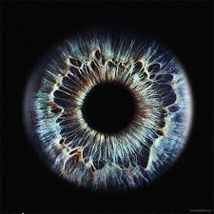
6. Eye Colour opposition
Sophie ‘Lumberjack Attack’ Mance
☺
Notes:
Thank reporter

Slide 2
The Problem
In certain human populations, genetics allows predicting inheritance of eye color among family members. In other populations of the present day World, nearly everyone has the same eye color. What information is it possible to determine about the eye colors in both distant and close ancestors, descendants, and relatives of one living person?

Slide 3
Clarifying questions
Can you please define….
How can a Punnett square predict exact eye colours?
Are these the only genes associated with eye colour?

Slide 4
Addressing the problem
Explanation of what determines Eye Colour
Predicting Inheritance Eye Colour
Data Collection Quantitative data collection
Genetic factors
Notes:
What causes/controls eye colour: how genes, melanin and light effect eye colour.
Predicting inheritance : Punnett squares etc.. Always just be a likely hood, there is no way to tell exactly what someone's eye colour could be.
Determining past eye colours: how it can be done. Associated snp’s with certain genes.
Data collection: has data to show how eye colour is passed
A final conclusion is made, based on collected data and supported by a correct and applicable explanation

Slide 5
Strengths
Theory
Practical
Definitions
Defined a polygenic trait
Explained a punnett square
Mentioned two key genes
Collected data to show passing/inheritance of eye colour

Slide 6
Weaknesses
Theory
Practical
Linked genes
Incomplete dominance
Dihybrid crosses
Martin-Schulz scale
No analysis of own data
Notes:
Cant predict eye colour due to meiosis ect.
Relevant data: cant predict the eye colour of new born babies, or kinds under the age of 6 as melanin in their eyes can still develop

Slide 7
Points for discussion
How does meiosis and random fertilisation effect predicting eye colour?
Epistasis and linked genes
Can you explain why some populations have a large percentage of the same eye colour
Linked genes- how this affects the resulting phenotype
What are some possible ways to trace back eye colours in past relatives (ancestors etc.)
Is genetics the only way?
What about evolution?
Notes:
Due to the random nature of fertilization you will never know the exact outcome of an offspring's eye colour. Links to meiosis (crossing over and independent assortment)
Crossing over: when some genetic material is ‘broken’ off and attached to another chromosome
Independent assortment: when chromosome line up at the cell equator randomly giving a massive amount of possible outcomes.
SNP’s (single nucleotide polymorphisms: type of variation, changes the order of the 4 bases in DNA) can be used as genetic markers which can be used to trace back eye colour (if certain SNP’s are associated with a certain eye colour)
Populations:
The way blue eyes have spread there are certain areas with higher number of blue eyes. And other areas further away from the area that have a lot of brown eyes.
Natural selection: certain eye colours can be seen as more desirable, may produce more offspring’s.
When crossing two eye colours it is some times very unlikely to get another eye colour, can creates a population of mostly the same eye colour.

Slide 8
Meiosis:
Independent Assortment
Segregation
Crossing over
Random fertilisation

Slide 9
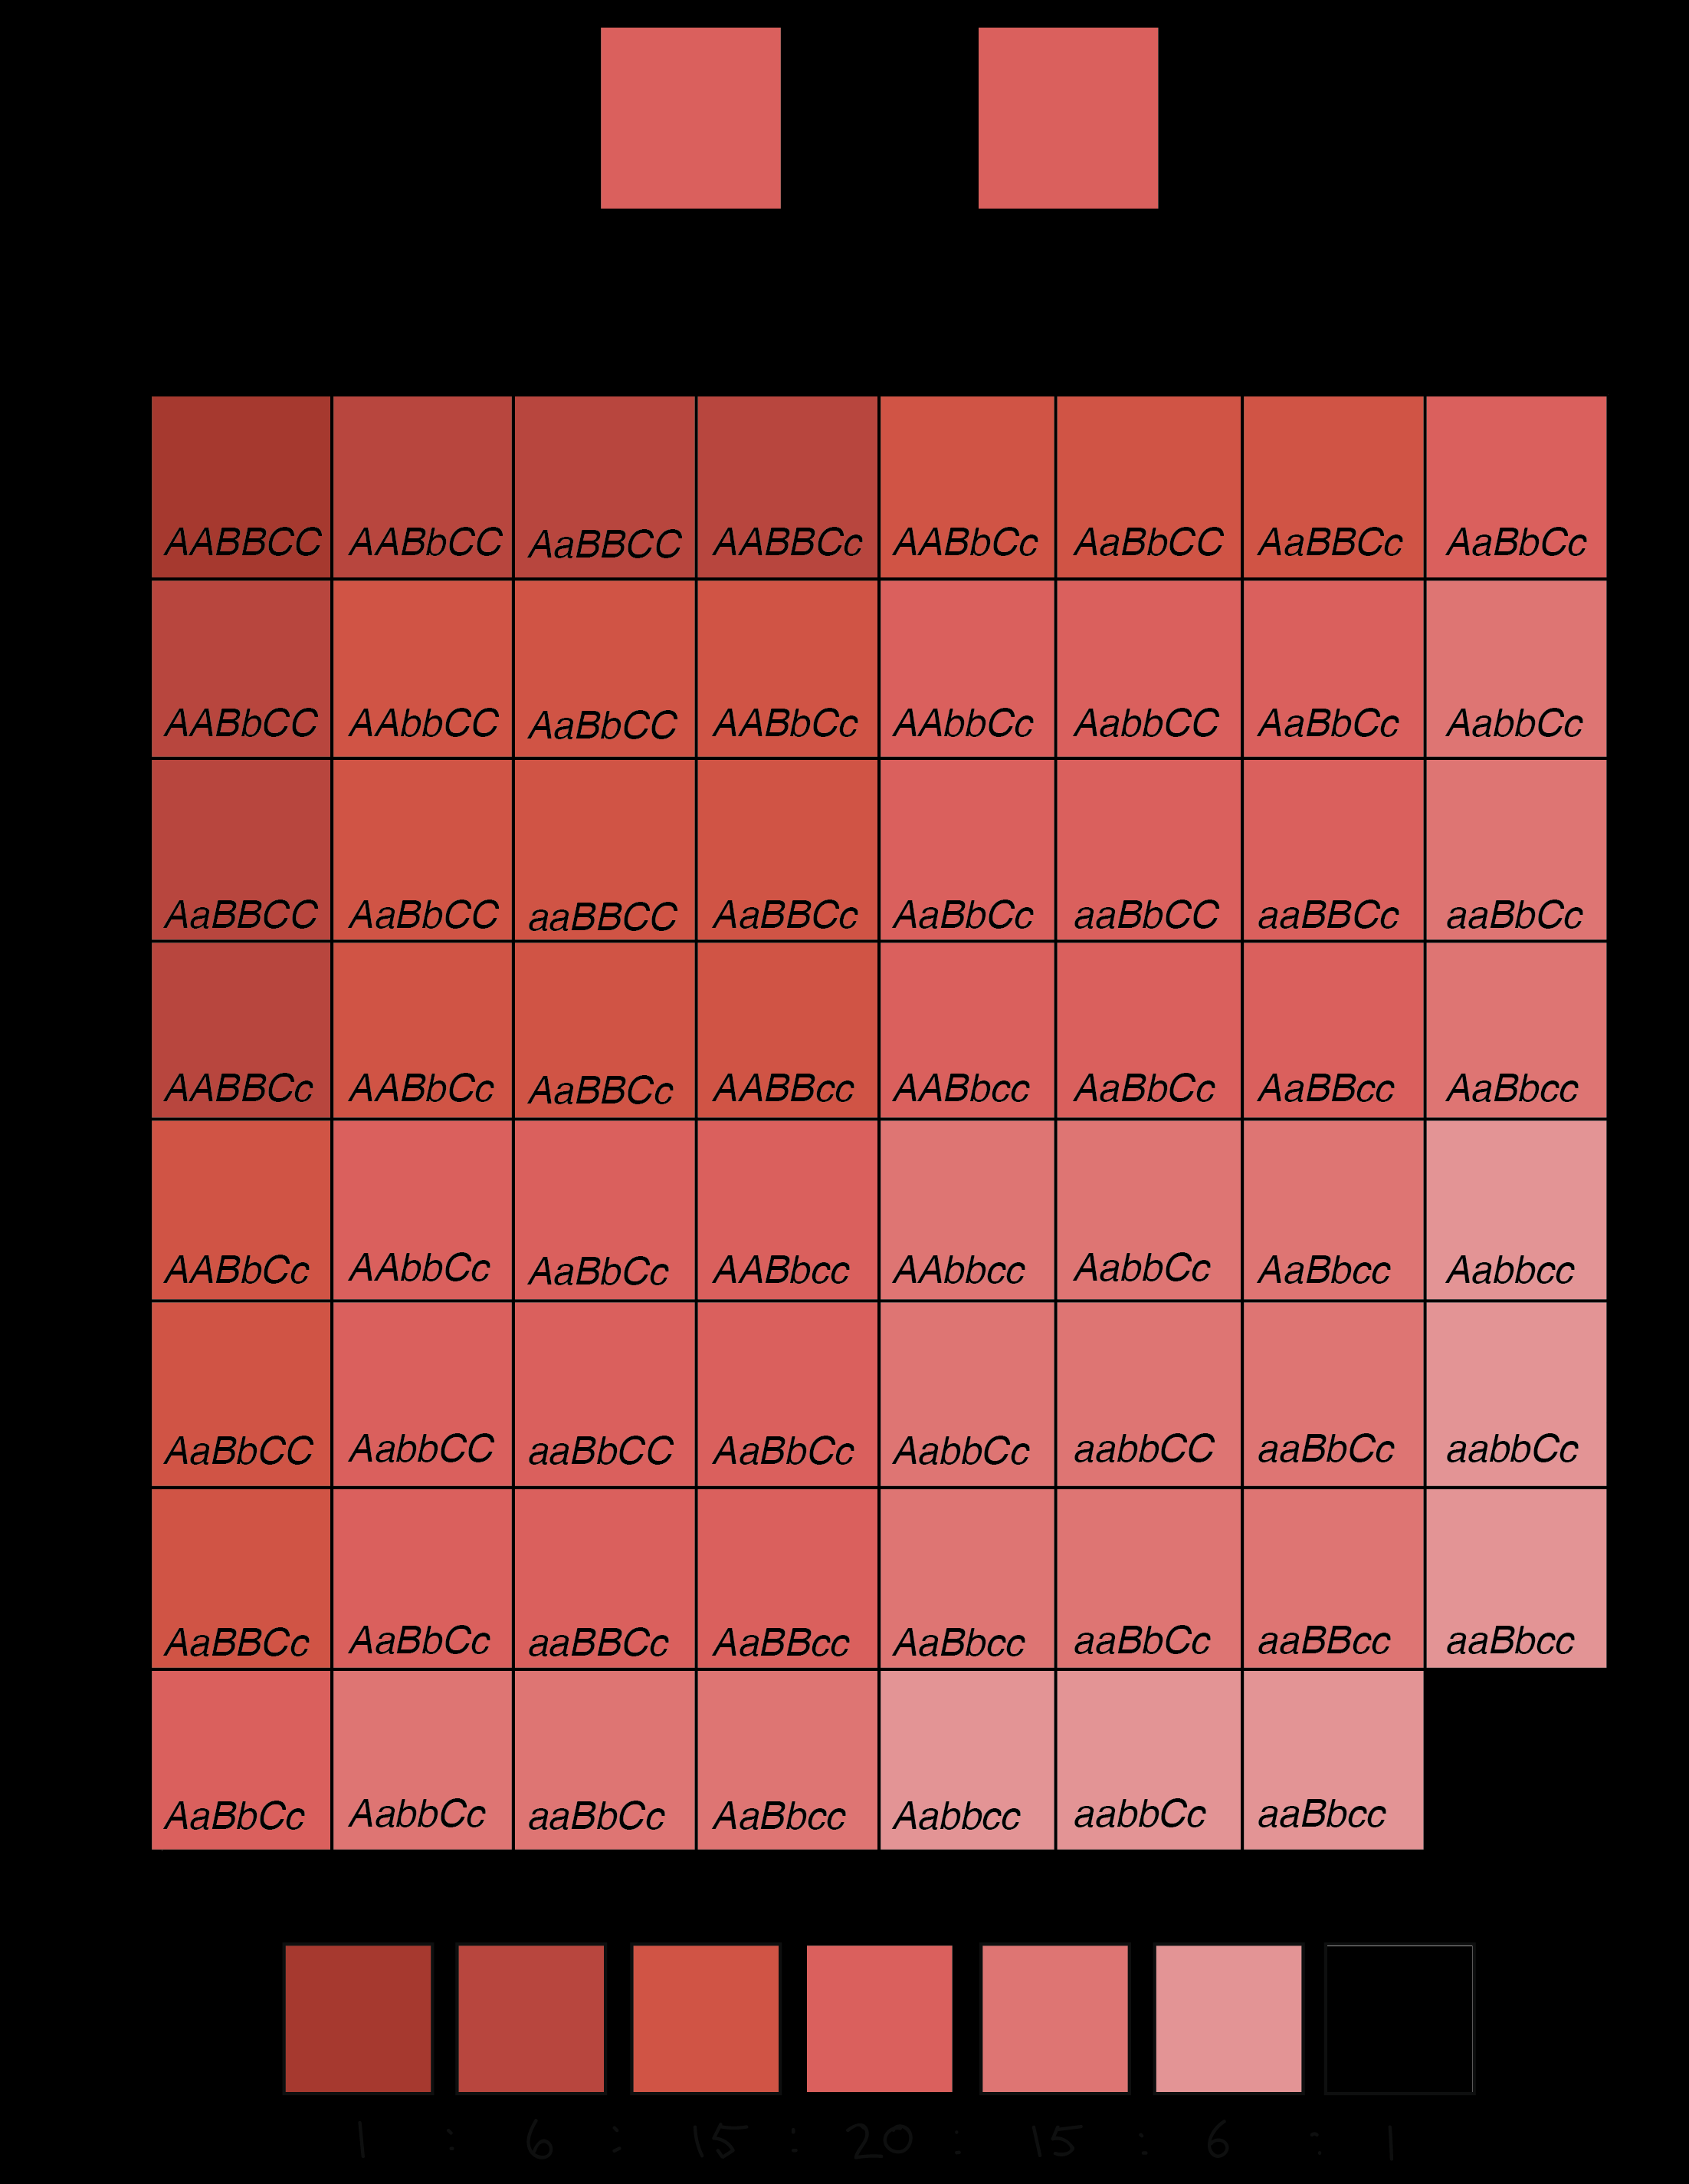
Notes:
Example of polygenetic inheritance-INCOMPLETE DOMINANCE. Did you take this into account?

